Slide 1
Cyclistic Members
vs. Casual Riders
Understanding how members and casual riders use the service differently
Presented by: Dennis Chesnes
Data from January 1, 2021 - December 31, 2021
Notes:
Maximizing the number of annual members will be key to future growth. Rather than creating a marketing campaign that targets all-new customers, we believe there is a very good chance to convert casual riders into members.

Slide 2
Agenda
Business Task - Member/Casual
Overview of the data - ride data, date/time data, location data
What trends emerge and how those trends differ from member to guest.
What do those trends mean and how can they be used to inform our next steps.
Appendix
Notes:
A quick look at what we’re going to cover today.
We’ll go over the questions I’m trying to answer.
We’ll dive into the data and see what trends and patterns emerge and how those trends differ from member to guest.
And then we’ll try to make sense of those trends and see how they can be used to inform our next steps.

Slide 3
How do annual members
and casual riders
use Cyclistic bikes differently?
Rides in 2021
Member Rides
Casual Rides
5,594,915
3,065,970
2,528,945
Notes:
In twenty twenty one, Cyclistic users took over five and a half million rides. Three million of those rides were by cyclistic members. That leaves two and a half million rides by casual riders.
So,how can we convert those 2.5 million casual rides into member rides? To answer that, we need to ask the question: How do annual members and casual riders use Cyclistic bikes differently? So, I looked at the ride data from all of 2021. This gave me date, time, and location data for every ride throughout the year. What I found was that casual riders tend to take casual rides, their ride numbers spike in the summer and on weekends, and they prefer parks, attractions and the lakeshore. While member rides tend to be around universities, business sectors and links to public transportation.
So it seems clear that what we are looking at is recreational riders vs. commuters. Let’s look at the relevant data.

Slide 4
Date and Time Data
Notes:
So, how did I get there? First lets look at the date/time data.

Slide 5
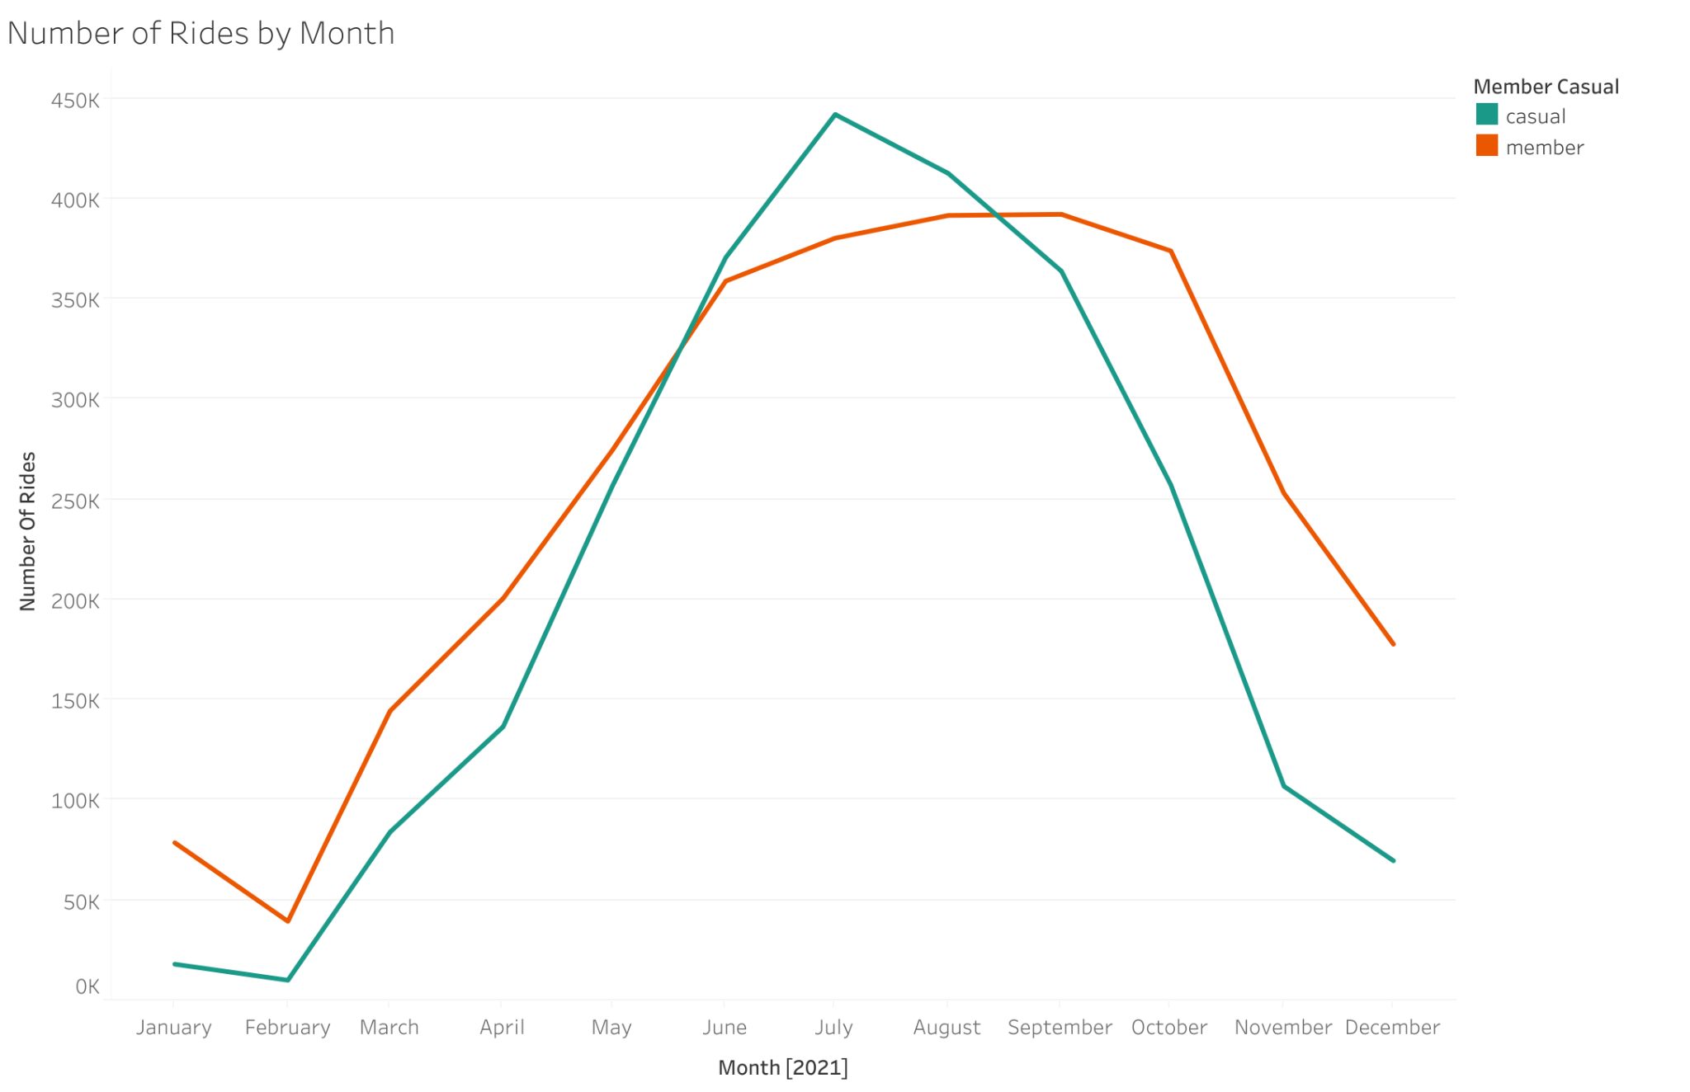
Monthly Ride
Numbers
Casual
Jul.
Feb.
442,048
10,131
Member
Sep.
Feb.
392,228
39,491
Notes:
A wide look at rides throughout the entire year shows rides increasing with the warmer weather. Casual rides have a noticeably sharper spike, overtaking member rides in the summer with a bigger drop of in the winter.

Slide 6
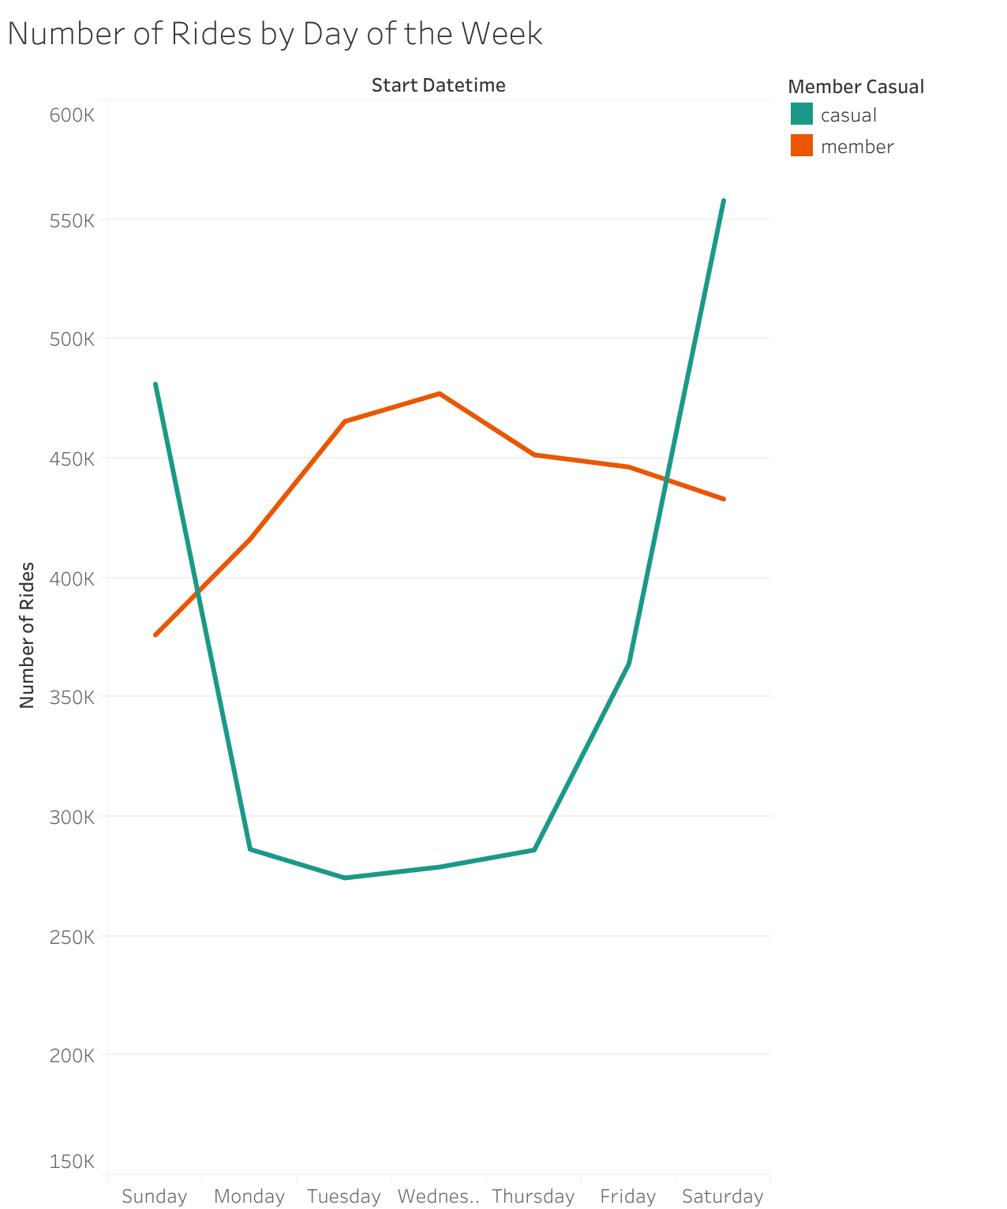
Daily
Ride
Numbers
Casual
Sat.
Tue.
557,993
274,388
Member
Wed.
Sun.
477,156
376,117
Notes:
Plotting weekly data shows daily casual rides doubling on the weekend while member rides stay much flatter and peaking on wednesday

Slide 7
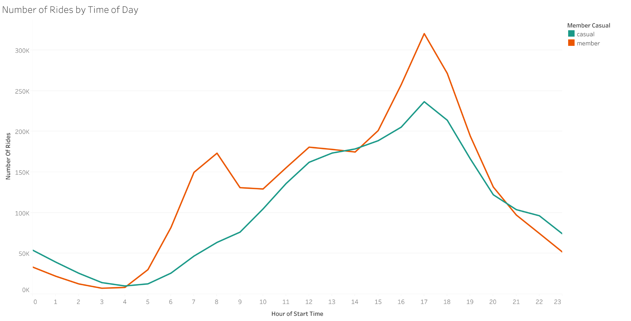
Hourly Ride Numbers
Mean ride length -
Notes:
And then zoom in for a look at hourly rides shows member rides peak at 8 AM and 5 PM. Business hours. And casual riders sleeping in and increasing through the afternoon until 5 PM.

Slide 8
Location Data
Notes:
So, summers, weekends, and afternoons are a strong argument for recreational riders, but where are they going?

Slide 9
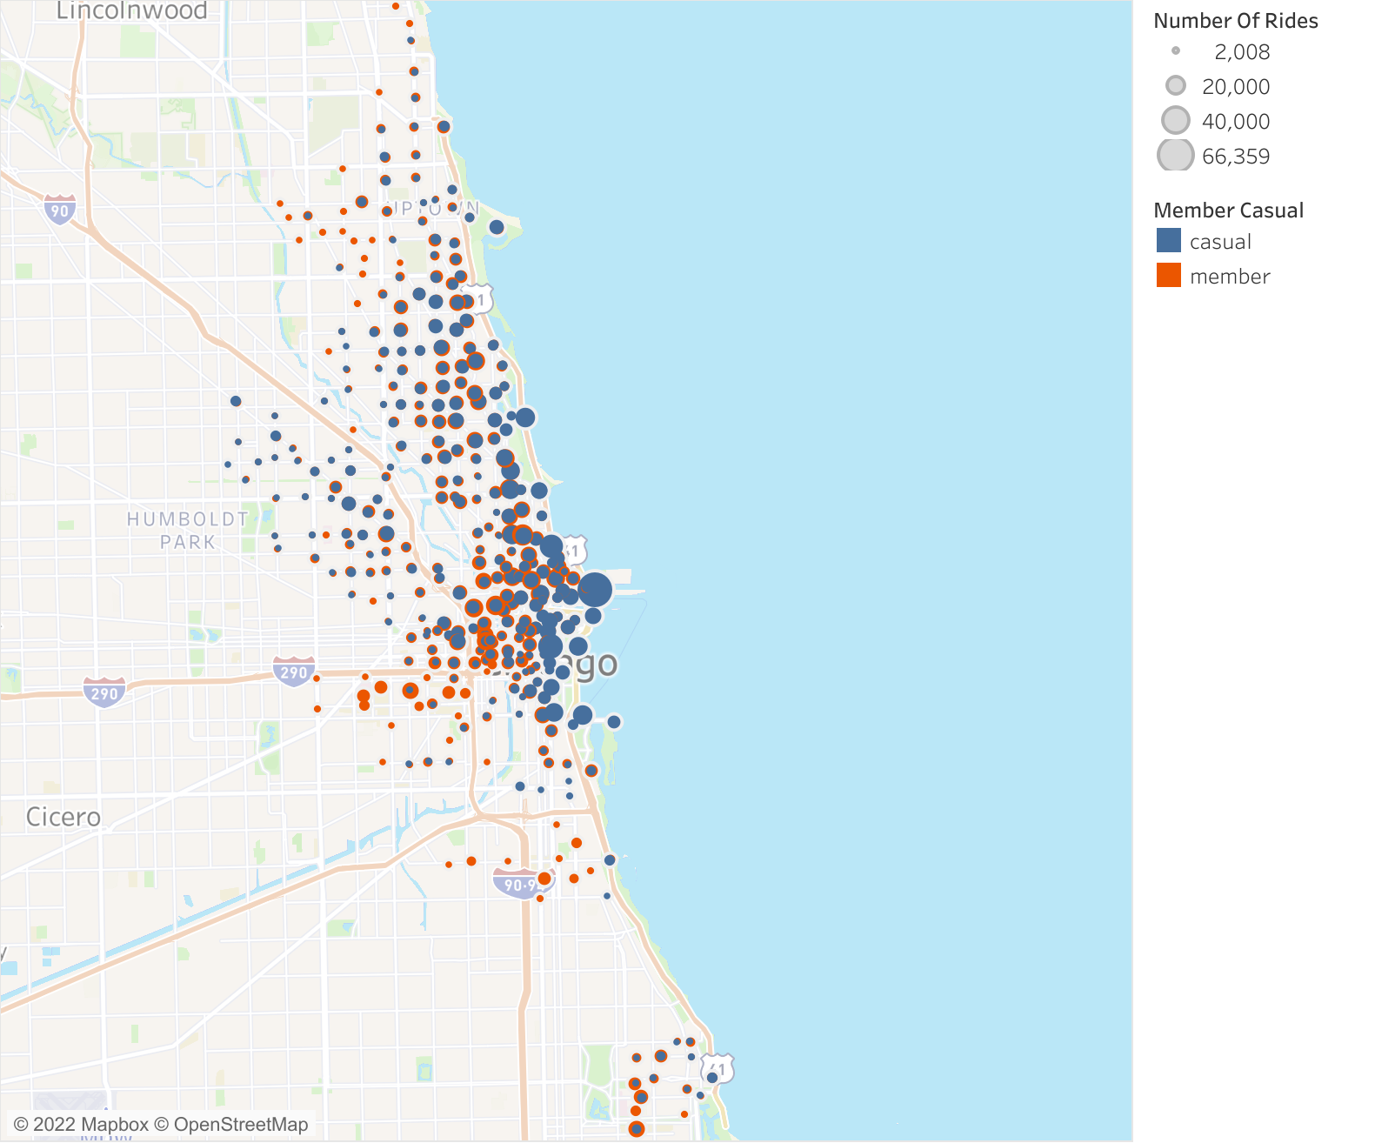
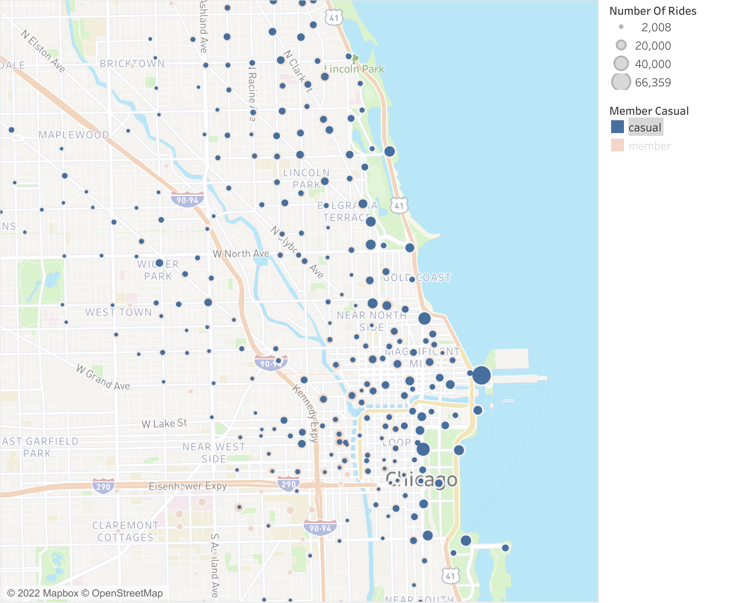
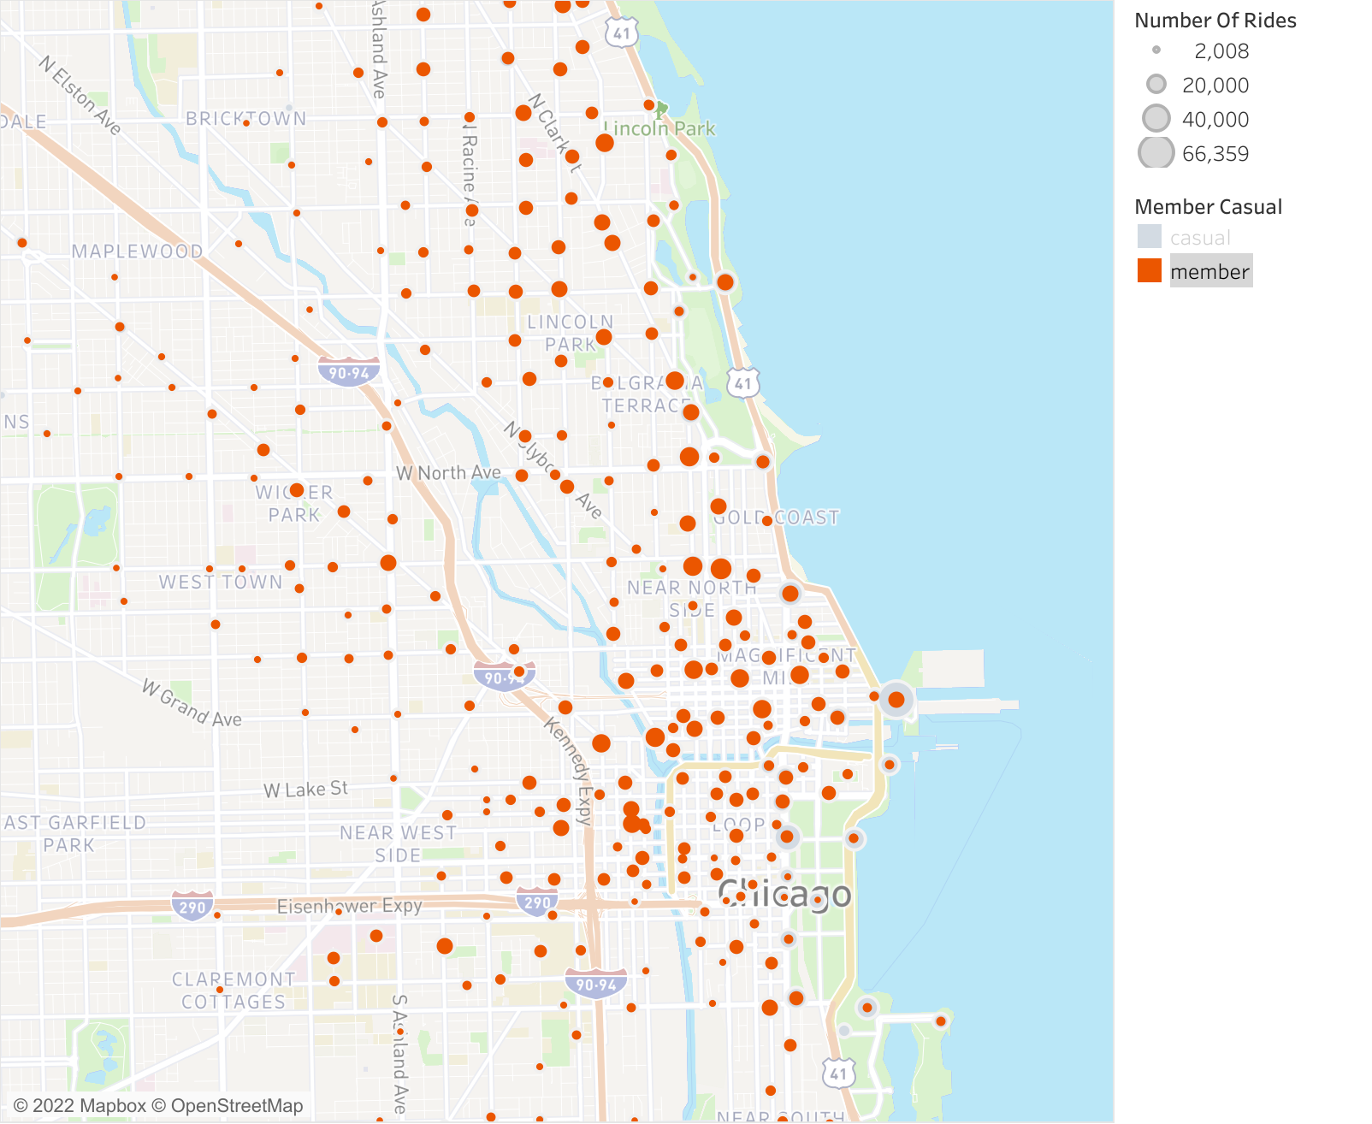
Station Popularity
Casual
Member
Notes:
We are looking at a map of Chicago. These blue dots are casual rides and the red, member rides. The bigger the circle, the more rides use that stop.
You will note the most popular stops for casual riders are the Navy Pier, Millennium Park, Oak Street Beach, Shedd Aquarium, and other parks. Many of these rides start and stop at the same station.
We also see that the larger circles for members are further inland by Universities, business districts and public transportation.

Slide 10
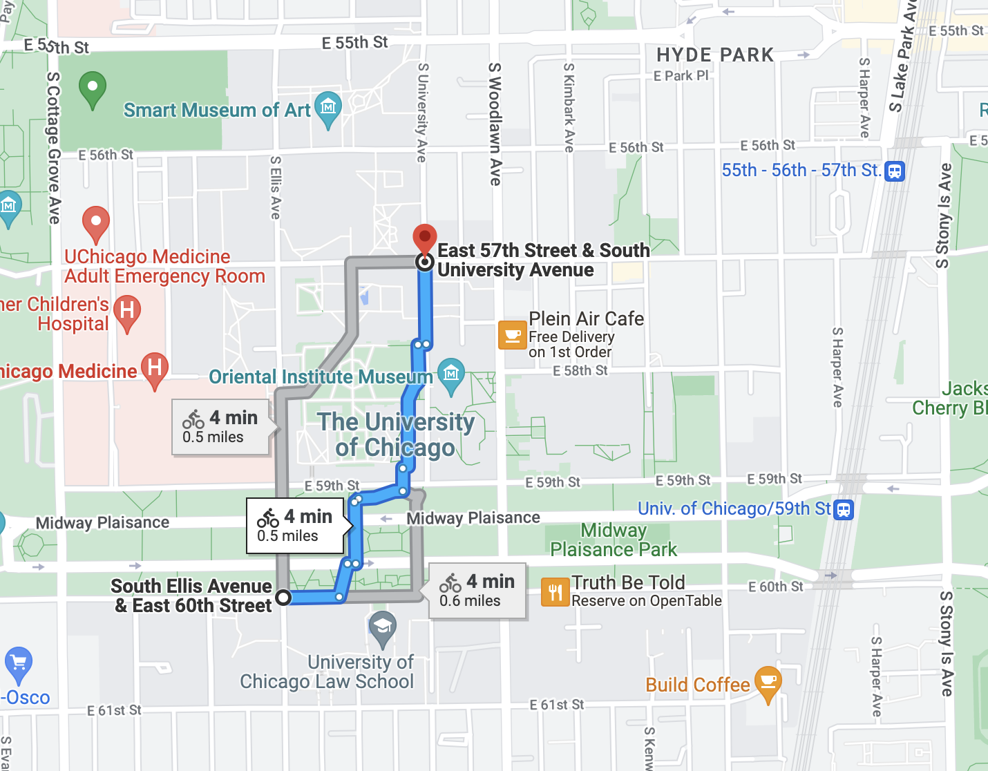
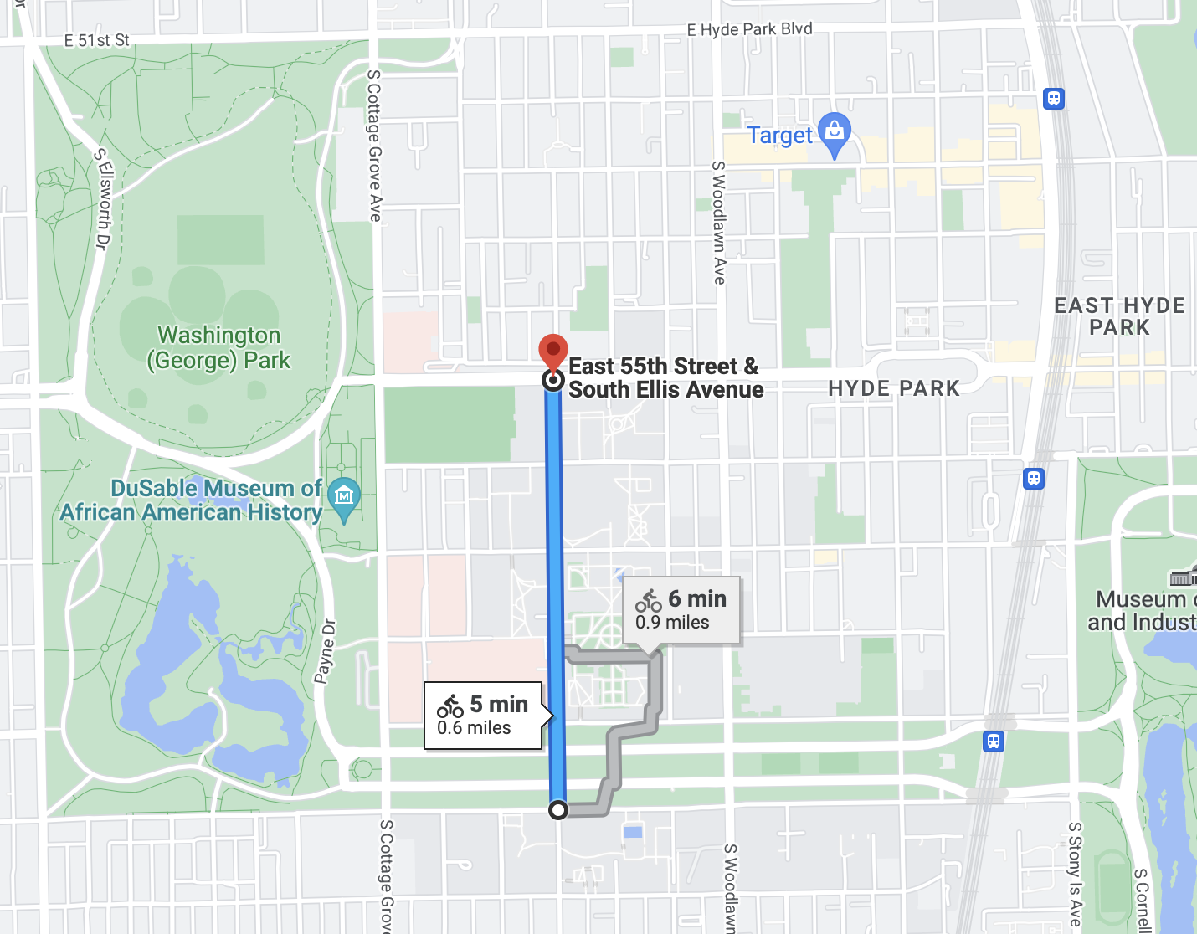
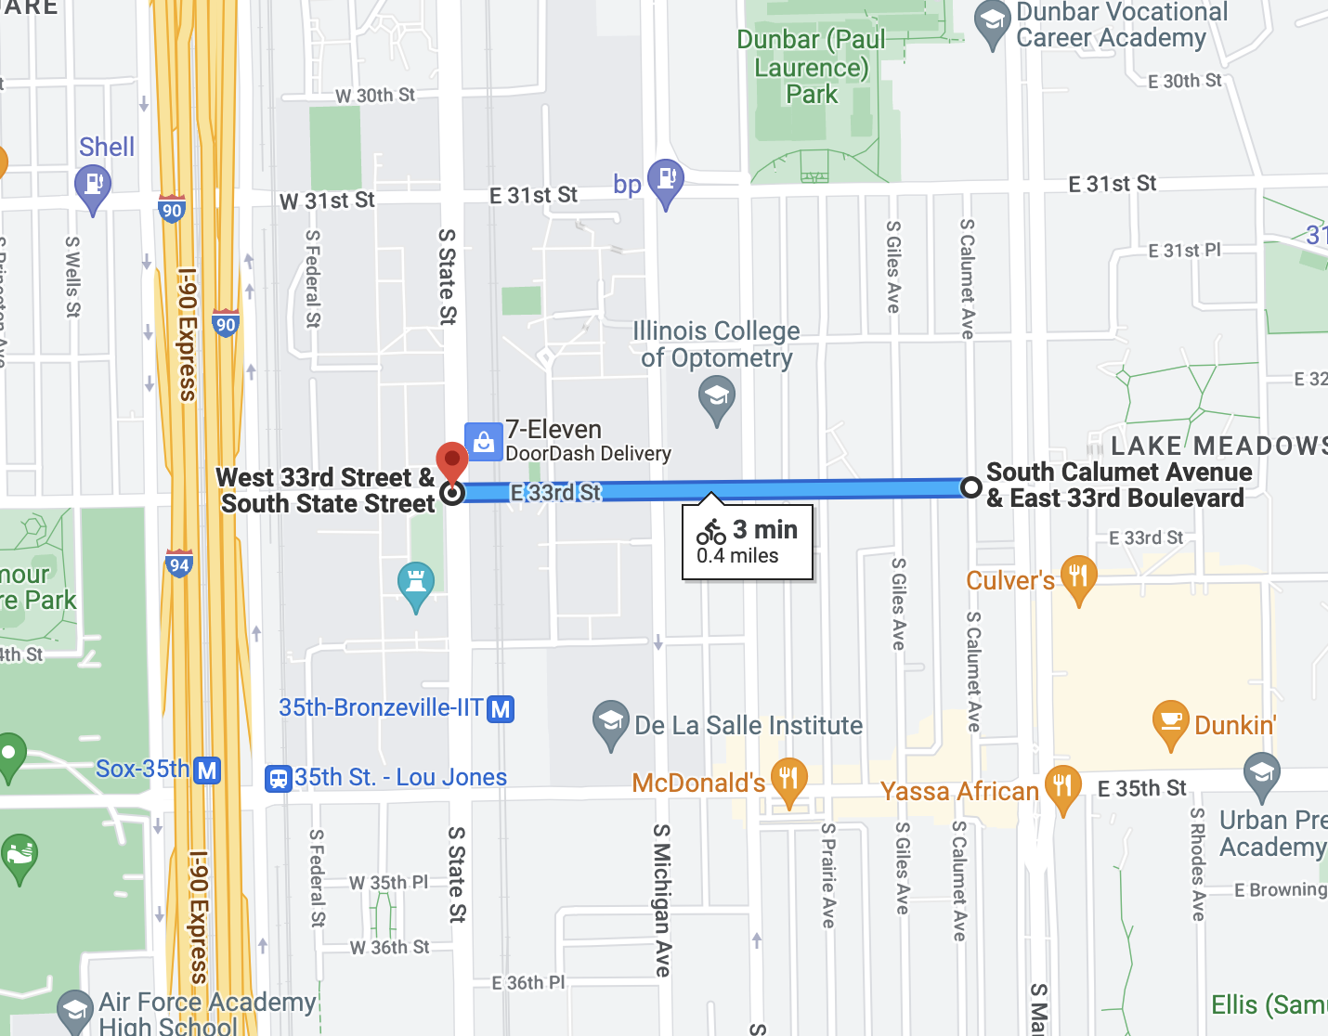
Most Popular Trips (Member)
Notes:
I also looked at the most common trips. That is to say, rides that share a starting and ending station. As you might expect, all of the most popular casual trips are the same as the popular stations, the pier, Millennium Park, and so on.
As for the member trips, these are the top three. Two across campus at the University of Chicago and one at the Illinois Institute of Technology.

Slide 11
Main Takeaways
Students use our bikes both casually and as members
Tourist activity
Further exploration
Notes:
Which leads me to my first conclusion, that the service is popular with students. The is a strong contingent of students among our members. However, there are plenty of casual rides on campuses that mirror members’ rides. These riders should be looked at when coming up with marketing strategies.
Second, increased ridership in summer and on weekends, as well as the popular stations for casual riders suggest tourist use our bikes often, as we might expect.
Furthermore, I would suggest that we take a deeper look at stops popular with both members and casual riders to see would could be the connection. Perhaps food hotspots, bars, etc.

